Slide 1
Capstone Project: Biodiversity in National Parks
Analyze data about endangered species

Slide 2

Data description
We are analyzing the conservation status of 5541 different species.
This species belong to 7 categories:
Mammal
Bird
Reptile
Amphibian
Fish
Vascular Plant
Nonvascular Plant

Slide 3
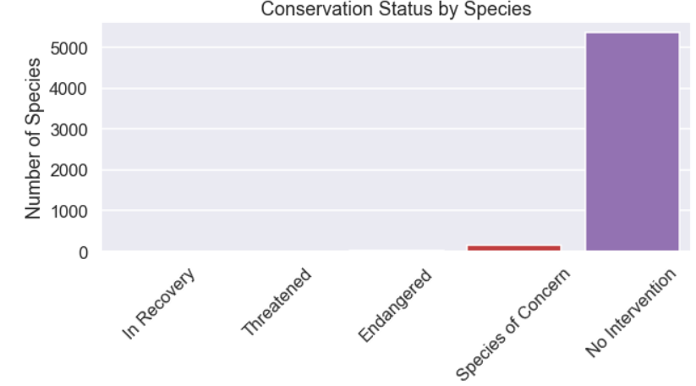
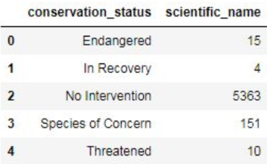
Endangered status between different categories of species
We are studying 5 different states: In Recovery
Threatened
Endangered
Species of Concern
No intervention
We clearly see that most of the species do not need any intervention
Since we are interested in the conservation status of each species, we decide to see how many species are in each of the different conservation status. We have displayed this information both as a table and a graph.

Slide 4
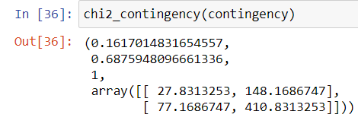
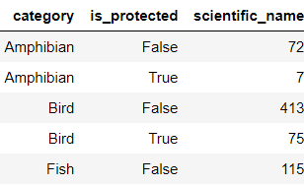
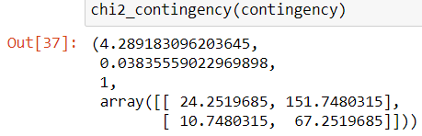
Are certain types of species more likely to be endangered?
After studying more in detail our dataset, we see that most of the species not in danger belong to Vascular Plant and only 1% are in danger.
On the other hand, we see that Mammal and Bird have the highest percent of species in danger: 17% and 15%. Are Mammal more likely to be endangered than Bird?
CHI SQUARE TEST ON SEVERAL SPECIES
It looks like species in category Mammal are more likely to be endangered than species in Bird. We're going to do a significance test to see if this statement is true.
It looks like this difference isn't significant!
Let's test another. Is the difference between Reptile and Mammal significant?

Slide 5
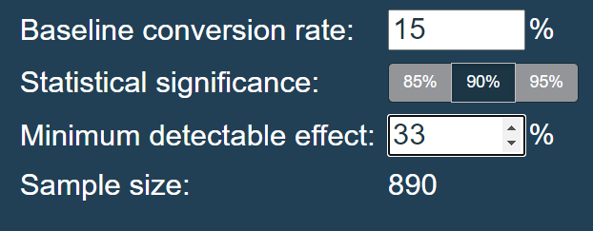
Sample size determination
Our scientists know that 15% of sheep at Bryce National Park have foot and mouth disease. Park rangers at Yellowstone National Park have been running a program to reduce the rate of foot and mouth disease at that park. The scientists want to test whether or not this program is working. They want to be able to detect reductions of at least 5 percentage points.
Confidence Level was provided by our scientists at 90%. Minimum Detectable Effect is calculated as a percent of the baseline conversion rate, since the baseline conversion rate is 15% and we want a reduction of 5%, we can divide 5% by 15% which gives 0.333 and multiplying by 100% gives us 33.33%. Inputting all this information to the calculator return a sample size of 870 sheeps needed for the observation.
For our scientists at the Bryce National Park this means they will have to observe sheeps for 3.5 weeks and for our scientists at Yellowstone National Park for 2 weeks.

Slide 6

Thank you!

